Slide 1
Vegan Gem Web Application
Created by: The CODE STARS-Alumni
Andrew Rice & roby rangel

Slide 2
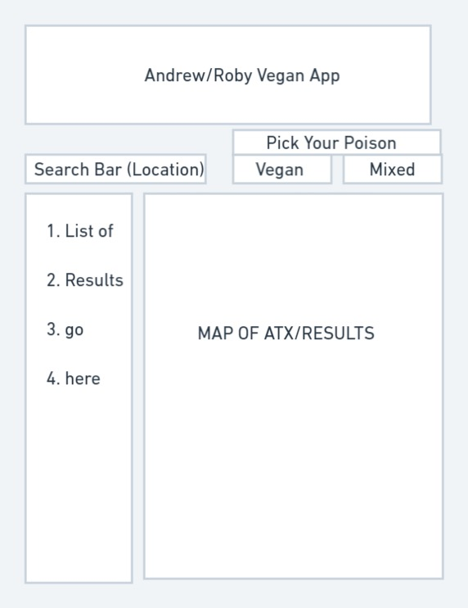
User Story
Evaluate & Plan
Vegan Gems
The idea is to build an app that will assist the good people of Austin in their pursuit for the best vegan food our city has to offer.
In our app we are hoping to have a map that will display the locations of recommended restaurants, a list of the recommended restaurants, a filter that will toggle the difference between “vegan options only” and “mixed options”.
We would build the server and API for the restaurants and would not allow users to modify/add locations.

Slide 3
Technology Used
API-Google Maps
Bootswatch style framework https://bootswatch.com/journal/
Sequelize
Zeit for Deployment
Server-side APIs
Next.js.
Google-Maps-React
The library includes a helper to wrap around the Google maps API.
The GoogleAPIWrapper High-Order component accepts a configuration object which must include an apiKey. If you want to add maps to your app, read about this package.

Slide 4
Deployed Links
GitHub:
Live Site: https://project3.riceandrew.now.sh/

Slide 5
Questions?

